Slide 1


11 September 2021 : Team Triumvirate
AI-Based Natural Disaster Intensity Analysis using IBM Watson
Prepared and presented by:
Sanchita Kamath, K Y Srija, Aysha Afreen Althaf and Arul Anand

Slide 2


WHAT IS THE PROJECT?
Overview
This project generates a model based on previously clicked images, and identify the aftermath or ongoing disaster, and it’s intensity, by taking input in the form of video, live stream through webcam and images. The disaster will be identified and displayed on the OpenCV window, the latter two input formats
NEED FOR THIS PROJECT
This project shall help Government bodies and Rescue Missions in resource allocation and energy distribution. The bodies involved in helping the victims of natural calamities, can have a look at captured video frames in order to analyse the level of intensity.

Slide 3

Working
TRAINING THE MODEL
BUILDING WEB PAGES
INTEGRATING WITH FLASK
A CNN model is trained by analyzing pre-collected images of disasters, and their aftermaths. There are four classes of images, cyclone, earthquake, flood, and wildfires. When the user inputs, the model predicts. We built the model on IBM Cloud.
The webpages are deisgned to take in user input. There are 5 web pages: Home, Intro, Image, Video, and Webcam. The first two provide users information regarding the project, and the remaining take user input
The flask application has the code to take user input, and run it by the model, to give results. It has methods depending upon the webpage. The video and live-stream input is broken into captures, and the procured images are run through the model.

Slide 4

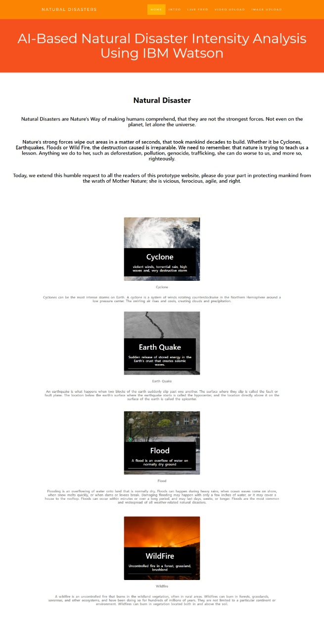
Home Page

Slide 5
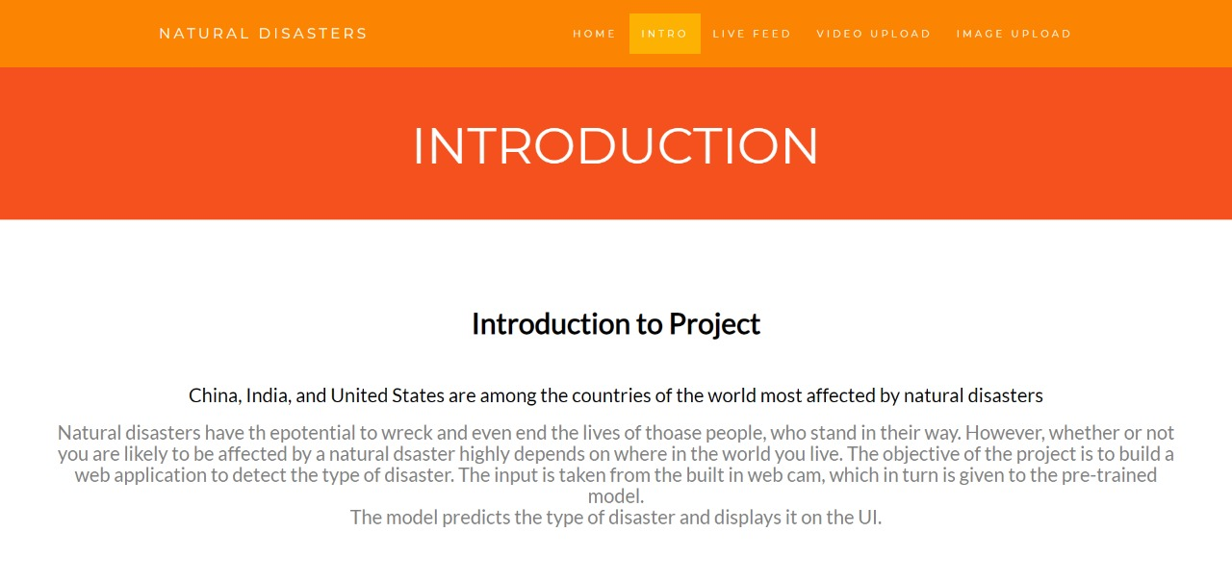
Intro

Slide 6
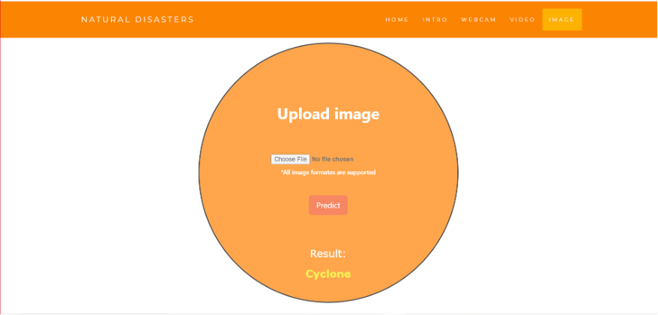
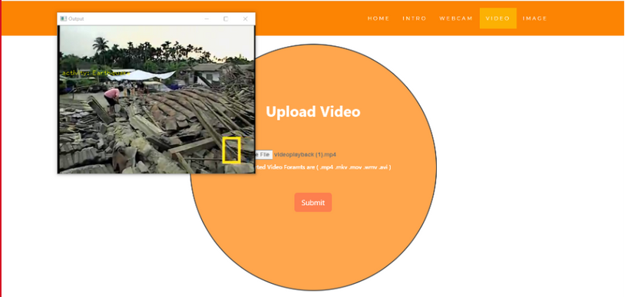
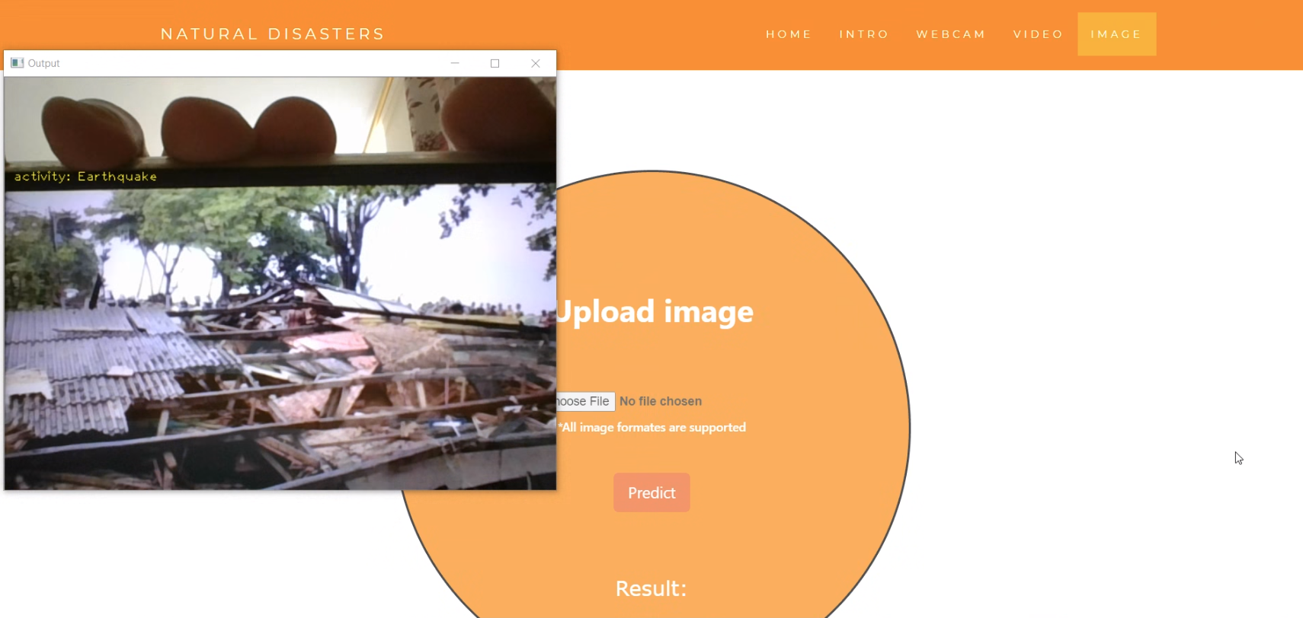
Uploads: Image/Video/Webcam

Slide 7


Conclusion
This AI and OpenCV project is helps take immediate action on protecting mankind from the aftermath of disasters that occur, and expeditious restoration of the landscape.
We hope that this project can be a starting contribution from us, to saving mankind from the wrath of mother nature. We admit that this approach, in no way, is exhaustive, it is simply a try to mitigate the disasters, whether or not they are triggered by human intervention to climatic conditions.

Slide 8
Future Scope:
This project doesn’t focus on prevention. Analysis might not be able to do that, maybe a few can be prevented by a change of habit. Analysis can only offer prediction in disaster management. An alternative project can be proposed wherein pre-disaster conditions are monitored to build a model, and a live camera is setup in places that are disaster prone, to analyze environmental movements and warn people to protect themselves and their families. This would impact the preparedness of the areas, since they would be pre-warned, that conditions are so forming, that a particular natural disaster is going to follow.
Also, a further expansion of this project would be assigning actual numbers to the intensity level of the disaster occurred.

Slide 9
Thank you!
FOR READING UPTO HERE

